Slide 1

IMPACT OF REMOTE WORK ON MENTAL HEALTH

Slide 2
Agenda:
What is Tableau?
What are the key Features of Tableau?
Overview of Data
Analyzing the data with the help of various visuals
Dashboard
Insights

Slide 3

What is Tableau?
Tableau is a data visualization and business intelligence tool used to convert raw data into interactive, shareable dashboards

Slide 4
What are the key features of tableau?
Drag-and-Drop interface: Allows user to create visualizations easily without coding
Data Connectivity: Connects to various data sources such as databases, spreadsheets, and cloud services
Interactive Dashboards: Users can interact with data visualizations through filters and actions
Real-time data: Provides up-to-date insights with live data connections
Advanced Analytics: Supports complex calculations, statistical analysis, and forecasting

Slide 5
Overview of Data
As remote work becomes the new norm, it's essential to understand its impact on employees' mental well-being.
This dataset dives into how working remotely affects stress levels, work-life balance, and mental health across various industries and regions.
With 5,000 records collected from employees worldwide, this dataset provides valuable insights into key areas like work location (remote, hybrid, onsite), stress levels, access to mental health resources, and job satisfaction.

Slide 6
Analyzing the data with the help of various visuals

Slide 7
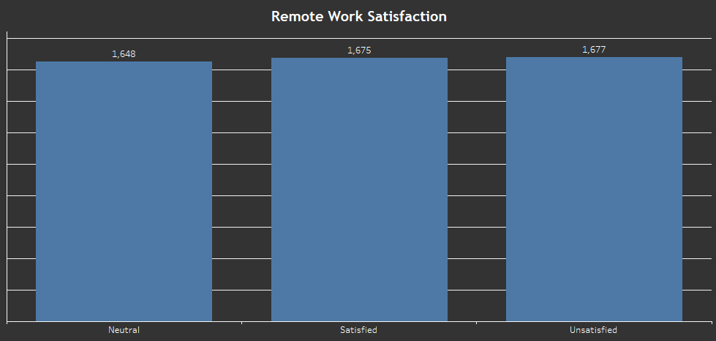
Column Chart
Column Chart presenting the count of employees that are satisfied, unsatisfied, or are neutral with the remote location

Slide 8
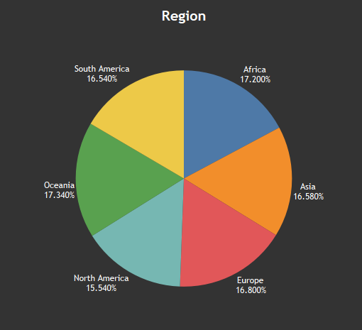
Pie Chart
A Pie Chart Showing the percentage of employees from each region/country

Slide 9
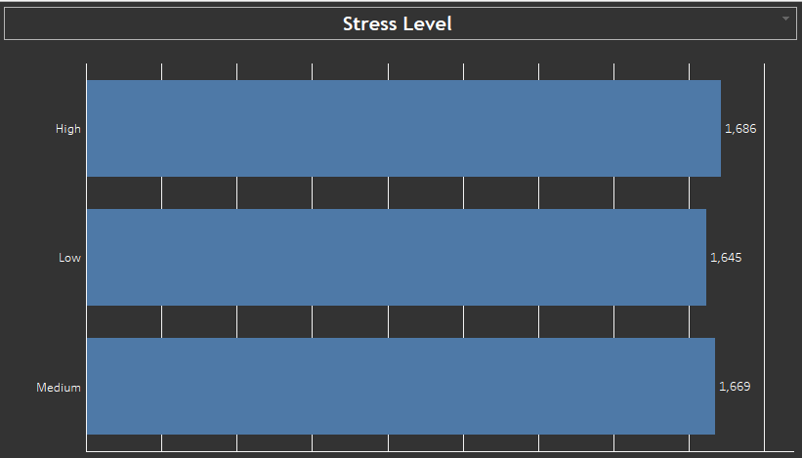
Bar Chart
A Bar Chart showing stress level wise employee distribution

Slide 10
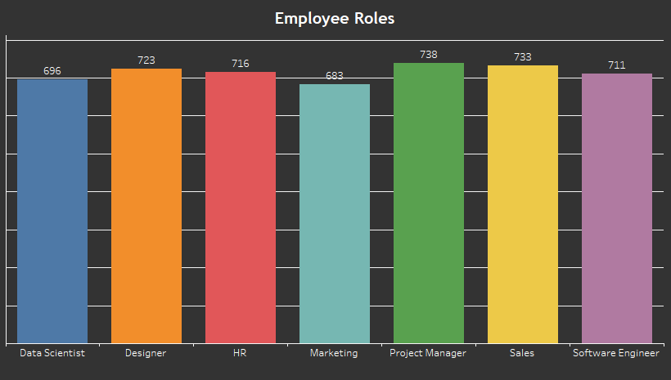
Column Chart
A Column Chart representing domain wise count of employees

Slide 11
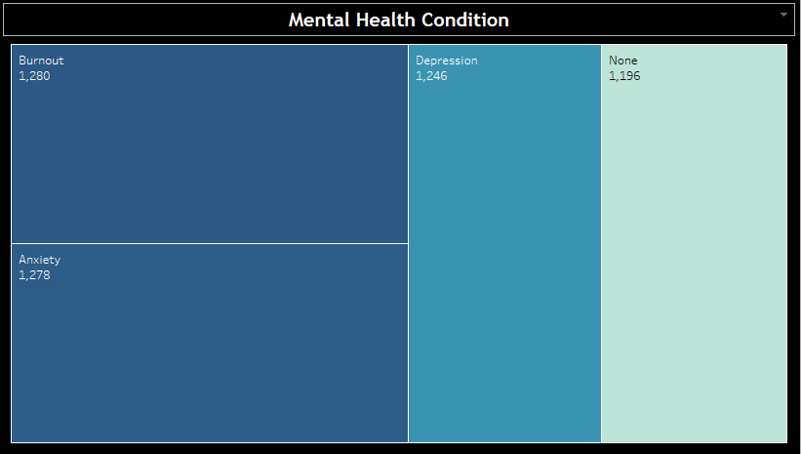
Tree-map Chart
A Tree-map Chart showing employee distribution by mental health condition

Slide 12
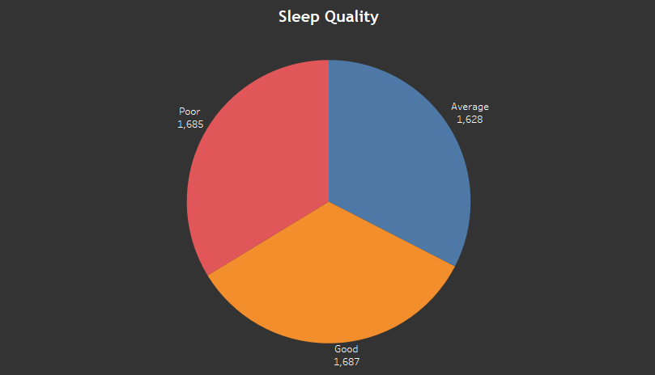
Pie Chart
A Pie Chart Showing the sleep quality of employees

Slide 13
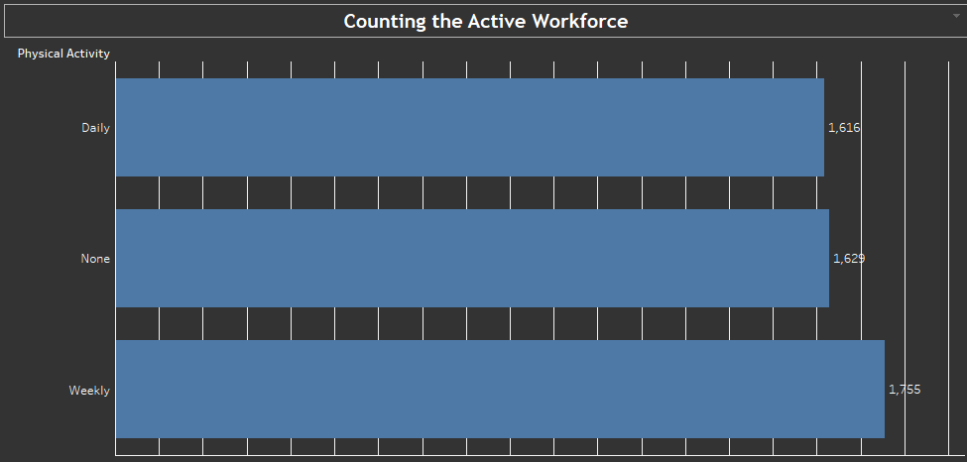
Bar Chart
A Bar Chart showing physical activity status of the employees

Slide 14
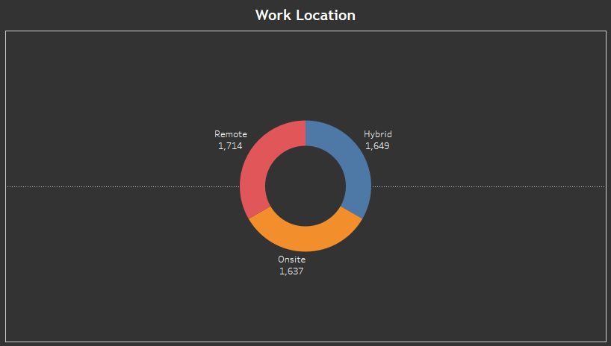
Donut Chart
A Donut Chart Showing distribution of employees according to the work location

Slide 15
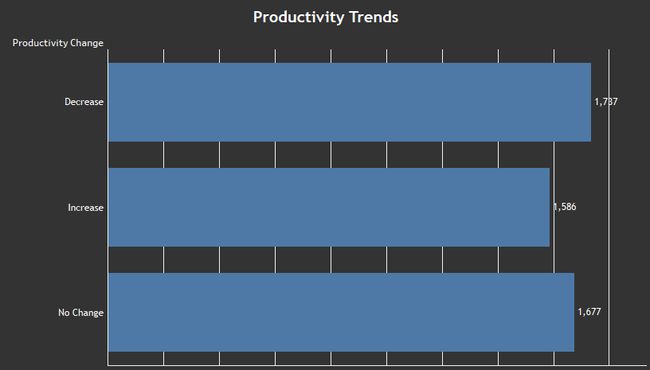
Bar Chart
A Bar Chart showing the status of productivity change of the employees due to the remote work

Slide 16

Dashboard is a single page, often called as canvas that uses visualizations to tell the story of your data
What is Dashboard?

Slide 17

Let’s take a tour of our Dashboard !!!

Slide 18
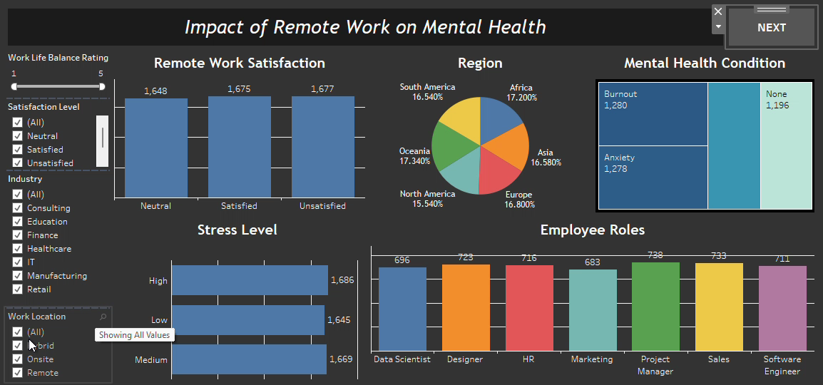

Slide 19
Insights
The employees working with Remote work location have high stress level as compared to the employees having Hybrid and Remote work location
Most of the employees whose Work-Life Balance rating is 5 (out of 5) are Unsatisfied with their Remote Location
The count of the employees that are having Low Stress Level is more than the employees having Medium and High Stress level. (Employees that are working Remotely with Work-Life Balance rating as 5 (out of 5))
The Productivity is Decreased for most of the employees that are working Remotely and have Good sleep quality
Employees that are working Remotely and having Poor and Average sleep quality have Increased their Productivity

Slide 20

THANK YOU

